Slide 1
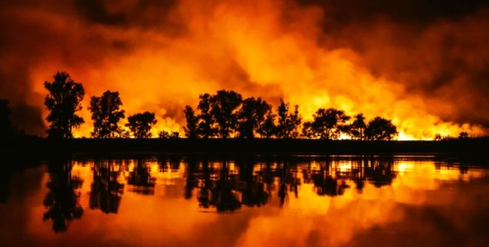
Wildfires/Combustion in Earth Systems
Chemistry
Learning Goal: Explore the science and history of wildfires, and connect them to climate change through greenhouse gas data analysis.

Slide 2
Introduction to Wildfires
What are wildfires? Conditions for fire (the fire triangle)
Cause of wildfires
Wildfire Impact on the Environment
Positive impact ( ecosystem)
Negative impact (human health, economic impacts, climate change)
Chemical Reactions in Fire
Climate Change: Cause or Consequence of Wildfires
How Wildfires Affect Our Community
Overview
Analyzing Local Urban Air Quality Data: Introduction of BEACO₂N sensors
How can we analyze data from BEACO₂N?
Data analysis using Google Colab notebooks:
Showcase of BEACO₂N sensors: Orange Sky Over the Bay Area
Group project: Exploration of Other Events in BEACO₂N Data
Lesson Outline

Slide 3
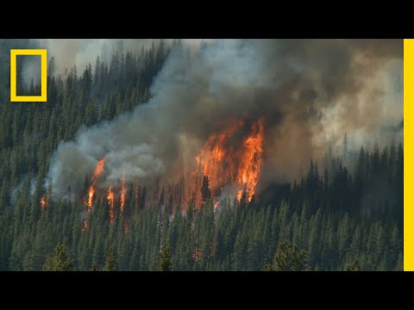
1. Introduction to Wildfires
What are wildfires?
As you watch the video, answer the following questions in your notebook:
How many acres usually burn each year in the United States?
What are the 3 components of the fire triangle? Draw the fire triangle.
What percentage of wildfires are caused by humans?
Notes:
Optional Slice

Slide 4
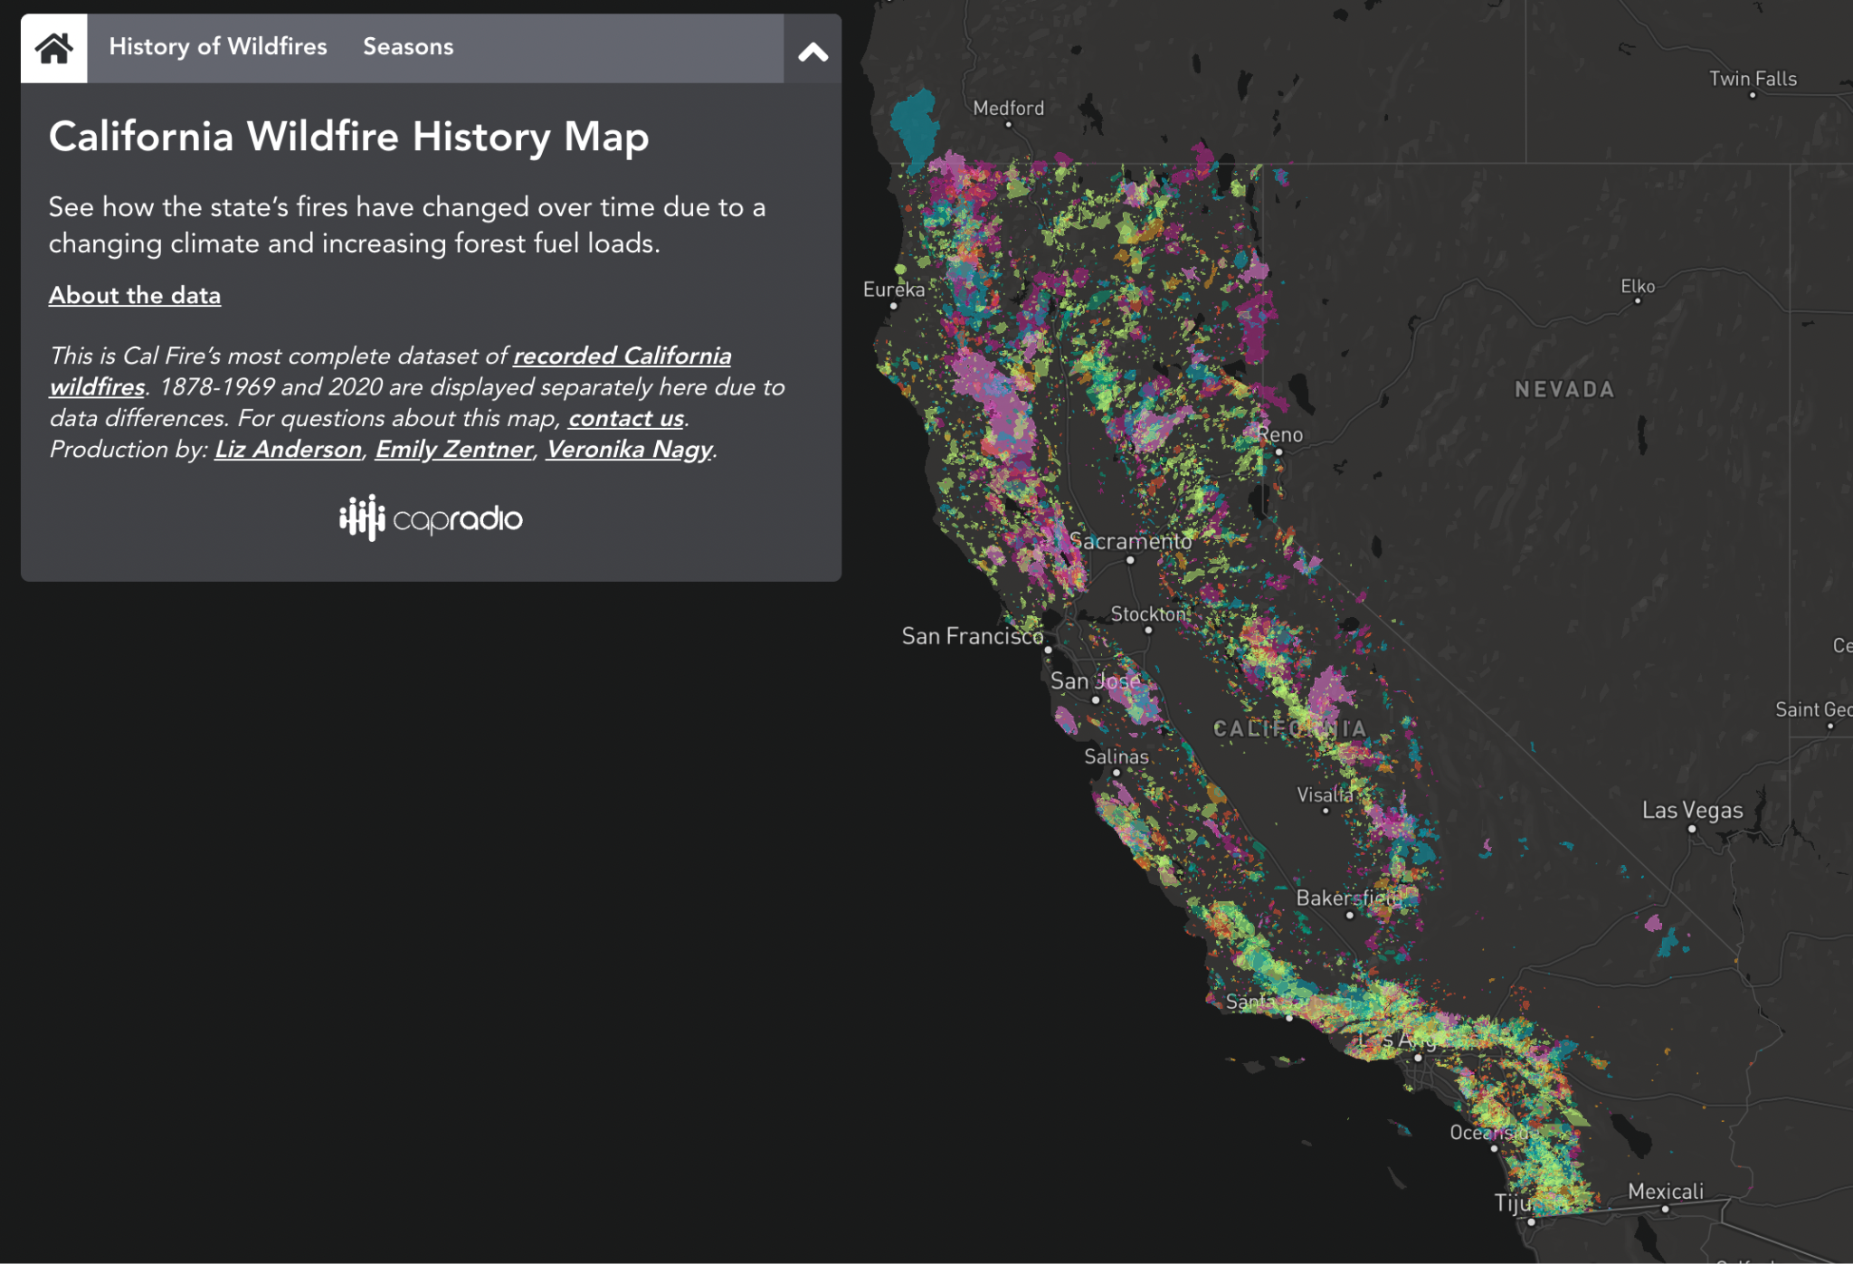
Analyze how wildfires have changed (size and number) since the 70s
Click here to interact with this graphic
Click the tab “History of Wildfires”.
Move the cursor to see the differents years .
After click on “2020” in “Other Timeframes” to see the size of the fires in 2020.
Write I notice a pattern… Describe what you notice about how the size and number of wildfires in CA have changed in the last 60 years.
Notes:
I Observe...
Observation is an important thinking skill. Help students hone their skills by regularly asking them to describe what they saw or what happened. Challenge them to observe without judgment - for example rather than saying, “The person wore an ugly shirt,” try, “the person wore a beige and sea-green striped shirt with large, bright pink spots.”
🍐 This is a Pear Deck Text Slide
🍐 To edit the type of question, go back to the "Ask Students a Question" in the Pear Deck sidebar.

Slide 5
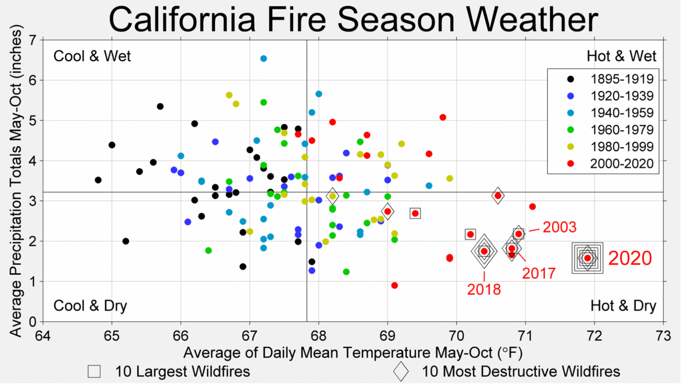
Causes of Wildfires:
How has Heat and Precipitation Impacted Wildfires in California?
Source Berkeley Earth
Write the answers in the your handout
What patterns can you find in this graph?
What can you conclude about how heat and precipitation impact wildfires in California?
Notes:
🍐 This is a Pear Deck Text Slide
🍐 To edit the type of question, go back to the "Ask Students a Question" in the Pear Deck sidebar.

Slide 6
2. Wildfire Impact on the Environment
Positive Impact:
Almost all of California’s diverse ecosystems are fire-dependent or fire-adapted. Fire-dependent ecosystems need wildfire to maintain appropriate function and health, while fire-adapted ecosystems have evolved to survive wildfire.
Fire can act as a catalyst for promoting biological diversity and healthy ecosystems, reducing buildup of organic debris, releasing nutrients into the soil, and triggering changes in vegetation community composition.

Slide 7
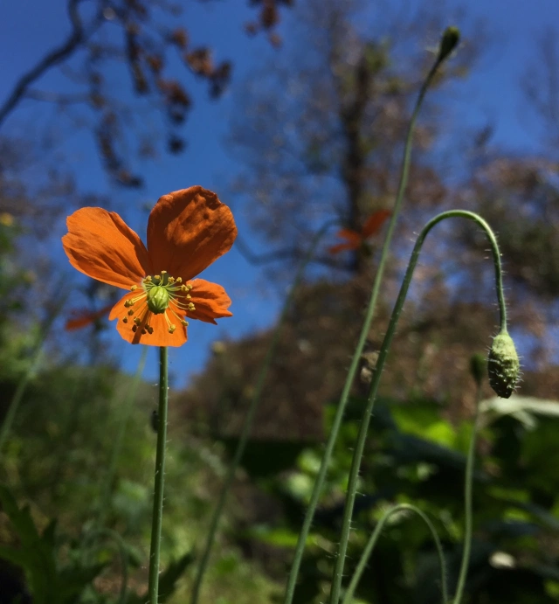
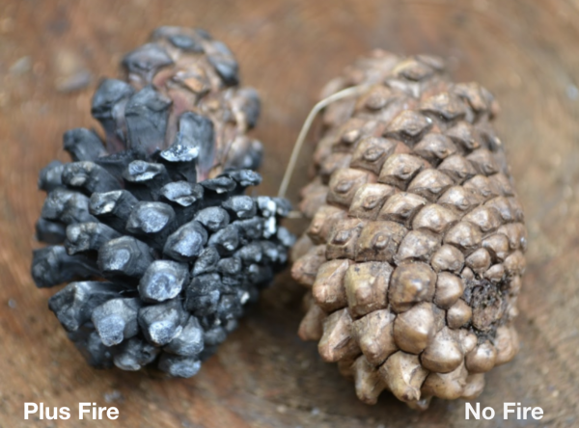
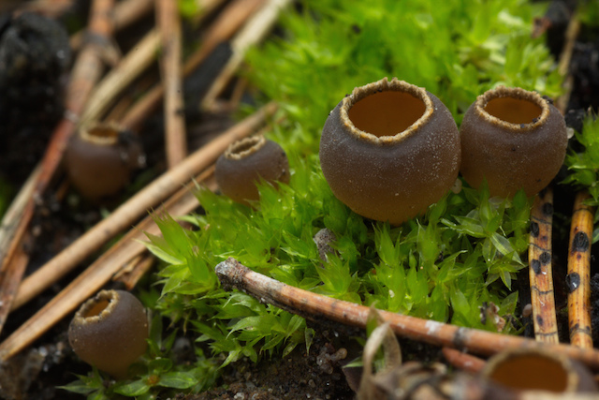
Fire is essential to California’s ecology.
Example: Chaparral Ecosystem
Geopyxis carbonaria (species of fungus) - Appear after fires to soak up nutrients from soil
Pinecones open after fire.
Fire Poppy (Papaver californicum) - Fire follower
Notes:
Chaparral - woody, resinous, lots of shrubs. As it ages, it burns more easily.

Slide 8
Negative Impact:
Wildfires impact on community health: One of the pollutants found in wildfire smoke is particulate matter. These particles are so small that they enter and lodge deep in the lungs and trigger asthma attacks, heart attacks and strokes.
Economic costs associated with wildfires include those incurred during and after the fire. Direct costs include damages to private properties, damages to local infrastructure such as utility lines, loss of timber resources, and aid for evacuated communities.
Wildfires affect the Earth’s climate. Forests store large amounts of carbon. When they burn, they release carbon dioxide into the atmosphere, which in turn contributes to climate change. After burning, forests also release carbon dioxide more gradually through decomposition.

Slide 9
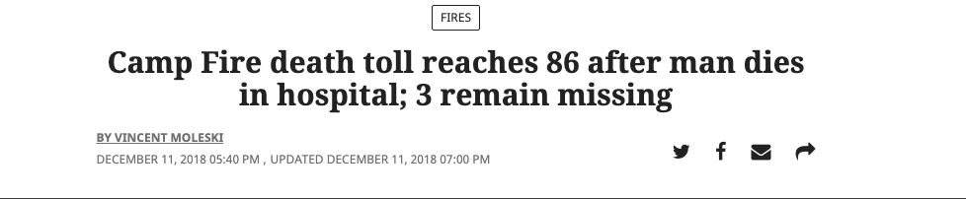
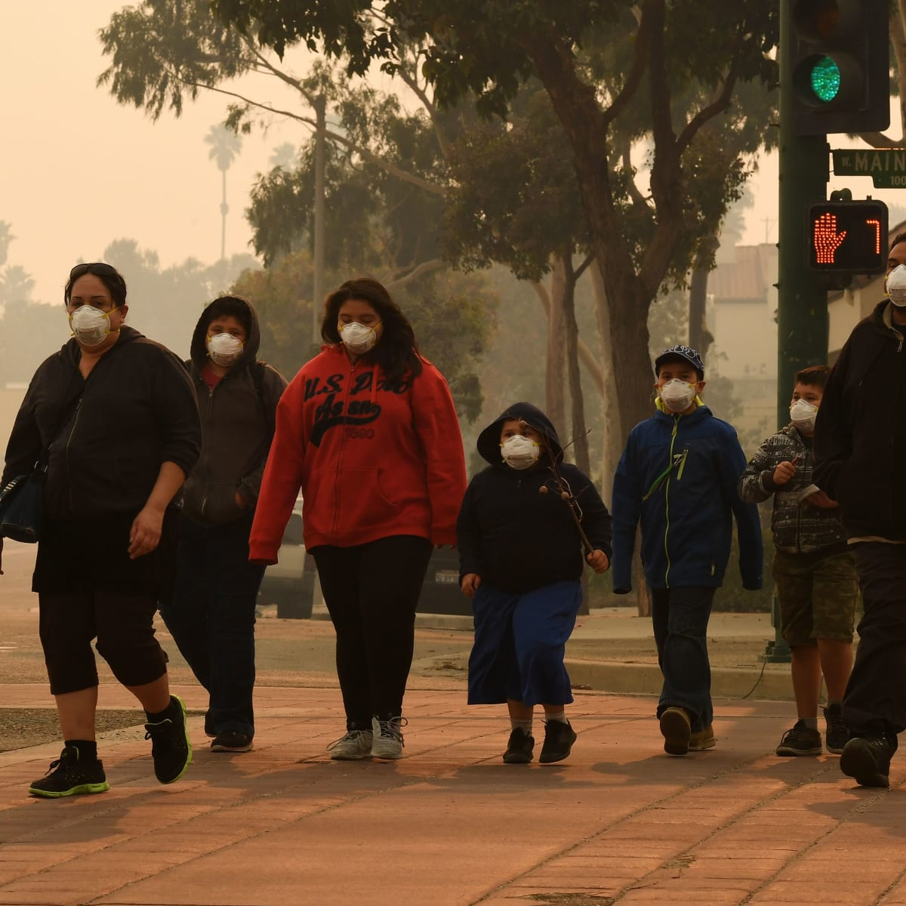
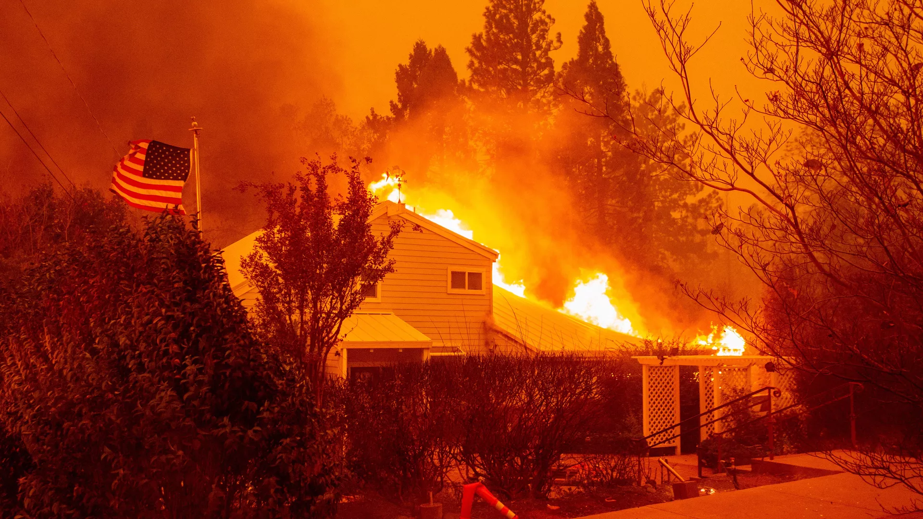
Impact on Community Health

Slide 10
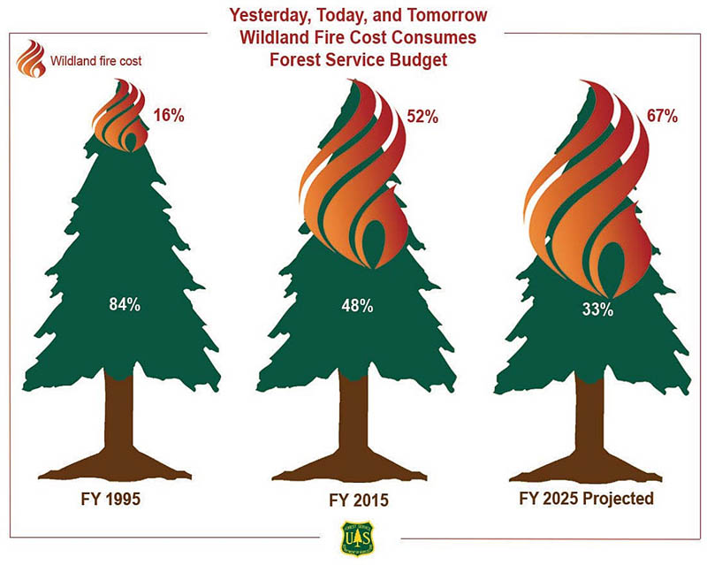
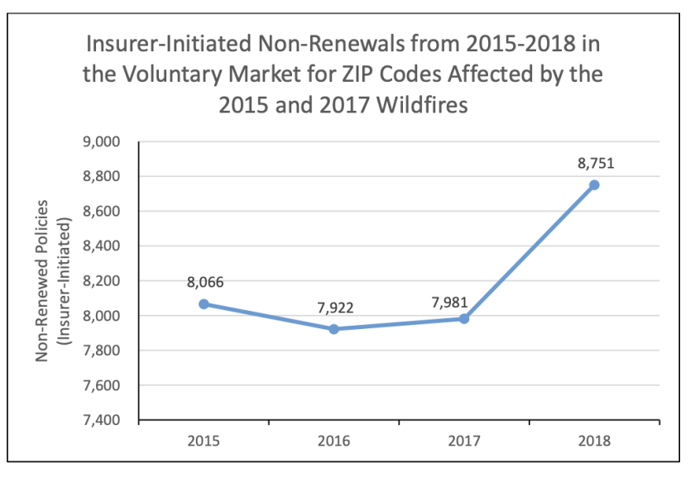
Economic Costs

Slide 11
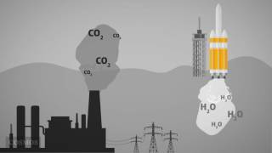
3. Combustion: The Chemical Reaction of Fire
As you watch the video, answer the following questions in your handout:
What is a chemical reaction?
What is needed for a combustion reaction to happen?
What does a combustion reaction produce?

Slide 12
4. Climate Change and Wildfires
Let’s do a reading activity to review information about how climate change related with wildfires:
We will use the jigsaw strategy to read three articles. Follow the instructions from the Student Handout (Section 4).
1 How Wildfires Can Affect Climate Change (and Vice Versa)
2.Frequently Asked Questions: Wildfire Emissions. Fire is part of Earth’s carbon cycle; combustion of fossil fuels is not.
3. Wildfire climate connection

Slide 13
5. How Wildfires Affect Our Community
Overview:
Remember that CO₂ is one of the products of the combustion reaction and therefore is a product of wildfires.
According to California’s Air Resources Board (CARB): the 2020 wildfire GHG emissions, were the worst fire year on record (by acres burned) for the State of California. The emissions estimate, 112 million metric tons of CO₂, is equivalent to the amount of carbon contained in the structural lumber of 6.3 million average California homes, or over 75 percent of all homes in California.
Carbon dioxide emissions from boreal forest fires have been increasing since at least the year 2000, reaching a new high in 2021, Zheng et al. report. Although boreal fires typically produce about 10% of global carbon dioxide emissions from wildfires, in 2021 they produced nearly one quarter of the total.

Slide 14
Part 1: Analyze Local Urban Air Quality Data
Introduction of BEACO₂N* sensors:h(video)
BEACO₂N is a new approach to observing atmospheric greenhouse gases (GHGs) over an urban area. Instead of using a small number of extremely sensitive instruments to measure a large area, BEACO₂N covers interesting locations with a network of sensors - called 'nodes' - approximately 1 mile (2km) apart from each other. Although the individual nodes are less precise than the highly sensitive traditional sensors, when working as part of a network, the nodes create a highly detailed map of CO₂ and pollutants in our air such as NO, NO₂, O₃, CO, and PM (particulate matter).
Summarize in your handout what you have learned about BEACO₂N from the video.
*Berkeley Environmental Air-quality & CO2 Network http://beacon.berkeley.edu/about/

Slide 15
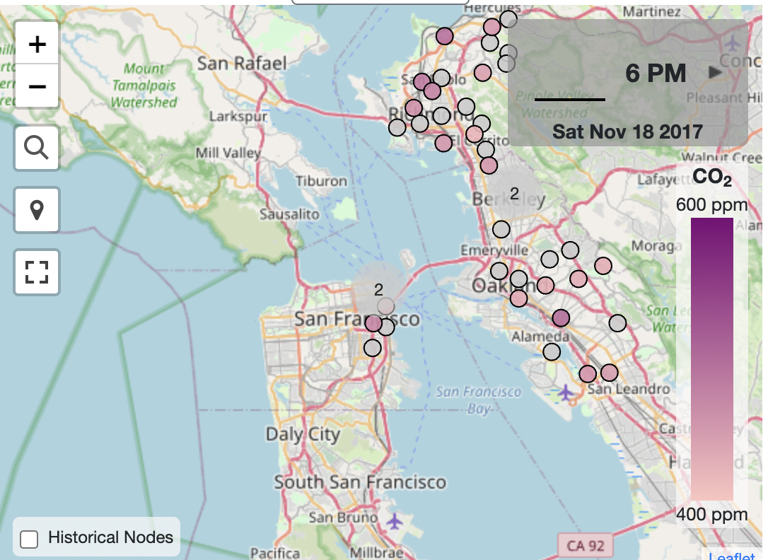
How can we analyze data from BEACO₂N nodes?
The data collected with BEACO₂N sensors is stored on a miniature computer and transmitted to a centralized server. It is saved as a '.csv' file (Comma Separated Values). Those files are widely compatible with software tools such as Microsoft Excel, Google Sheets, and Python libraries like Pandas which we use in coding. The CSV files are popular in data science due to their simplicity and ability to efficiently store and share large amounts of data. To analyze the CSV files produced by BEACO₂N sensors (nodes), we will introduce and use Jupyter Notebook (coding in a language called Python)
Yes, we are going to code!!

Slide 16
Part 2: Application of Data Analysis Showcase of BEACO₂N sensors: Orange Sky Over the Bay Area
On Wednesday, September 9th, 2020, Bay Area residents woke up to an orange sky and general haze that lasted throughout the day. These conditions were caused by record-setting wildfires burning across California, Colorado, Oregon and Washington state. The fires resulted in thick particle clouds that scattered blue wavelengths of light and left only reds and yellows, creating this odd red haze.
While visibility was affected on September 9th, it wasn't until the following day (Thursday, September 10th) that the air quality (as measured by Aerosol concentration) became dramatically worse, a trend that continued for over a week afterward. This poor air quality was recorded by several nodes in the BEACO₂N network.

Slide 17
Group Project using BEACO2N data:
If you haven’t already, open your IN CLASS: Wildfire Combustion notebook.
After completing the In Class notebook, summarize what you learned about CO₂ and PM2.5 concentrations during wildfire periods in the handout.
——————————————————————————————————————————
If you haven’t already, open your EXPLORATION: Wildfire Combustion notebook.
Work through Sections 1 and 2 of the notebook.
When you reach Section 3, proceed to the next slide for instructions.
Notes:
Optional Slide

Slide 18
Group Project using BEACO2N data:
We will separate the class into three groups, each studying a specific pollutant: CO2, NOx, or PM (particulate matter).
Each group will explore that pollutant during a wildfire period using BEACO2N data. Complete section 3.1 in the notebook to load your corresponding data. Complete section 3.2 about Data Visualization and analysis.
Answer Q3 and Q4 in section 3.2 of the notebook. This requires collaborating with another group. This section helps you brainstorm for the last part of this project!
Notes:
Optional Slide

Slide 19
Group Project using BEACO2N data: (continued)
4. Finally, each group will do a presentation showing their findings!
Format options:
Poster
Slide deck with voice-over
Presentation duration: 5 minutes maximum
Requirements to include:
Research about how wildfires affect your pollutant.
The results of your data analysis in your notebooks and an explanation of them. Include your plot and a table of summary statistics (use .describe() on your DataFrame like we did in the In Class Notebook)
A conclusion that links your data analysis with your research findings.

